Slide 1







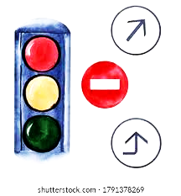
Traffic Prediction
-By Team SciPy
INSIGHTS

Slide 2


PRESENTERS
OTHER ACTIVE MEMBERS
Gozie Ibekwe | Babatunde Raji
Pragati Thakur | Zainab Mohammed
Fidel Imasuen | Djardo Isaac
Oguamanam Chinyere P. | Bernard Boateng
Subair Hussein K | Samuel Nnamani
Lakshay Arora | Bissalla Daniel
Zainab Mohammed | Emekobong Udoh
Odion Sonny-Egbeahie | Omotayo Waheed
Kevin Outta
Joshua Obikunle
Bertram Okonkwo
LEADS
Team Lead- Chisom Promise
Ass.Team Lead-Pearse Jim
Query Analyst- Victoria Udoh

Slide 3







Topics of Discussion
Problem Statement and Objectives
1
6
Conclusion
2
5
Existing Solutions
EDA and Modelling
Dataset Description
3
4
Our Approach

Slide 4
Problem Statement and Objectives
The aim of this project is to derive insights from data analysis and then build a model/models that can be used to predict traffic at particular times at the different junctions in the city.
Problem Statement
The model should not take too long to return prediction
To minimize the Root Mean Squared Error (RMSE) as well finding (MAPE)Mean Absolute Percentage Error
To check if model is overfitting with stratified cross validation.
Objectives

Slide 5

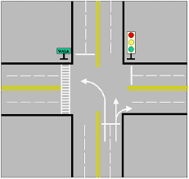
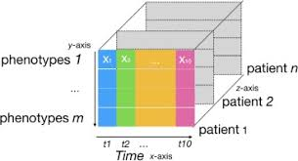

Existing Solutions
Concept 1
Concept 2
Concept 3
Concept 4
One of the research paper on Spatiotemporal Latent Factors of Traffic via Regularized Tensor Imputing Missing Values and Forecasting used TRTF Model.
Temporal regularized tensor factorization framework (TRTF).
It models traffic data as follows. First, the road network of a city is modeled as a directed graph in which nodes are junctions and edges are road segments linking junctions.
But the problem was with non-negativity constraints to TRTF. The highest fraction of negative values generated by method throughout all the experiments did not exceed 0.7 percent.
Notes:
LINK: https://ieeexplore.ieee.org/document/8917560
temporal regularized tensor factorization framework (TRTF) suitable for high dimensional time-series analysis. TRTF models traffic data as follows. First, the road network of a city is modeled as a directed graph in which nodes are junctions (e.g., intersections, Y-merging, roundabouts, etc.) and edges are road segments linking junctions

Slide 6

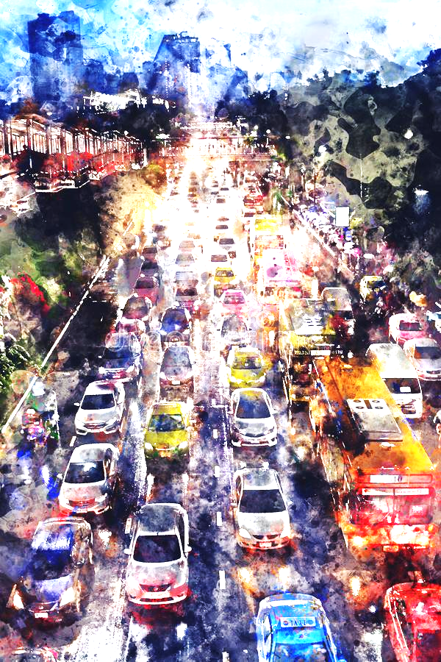




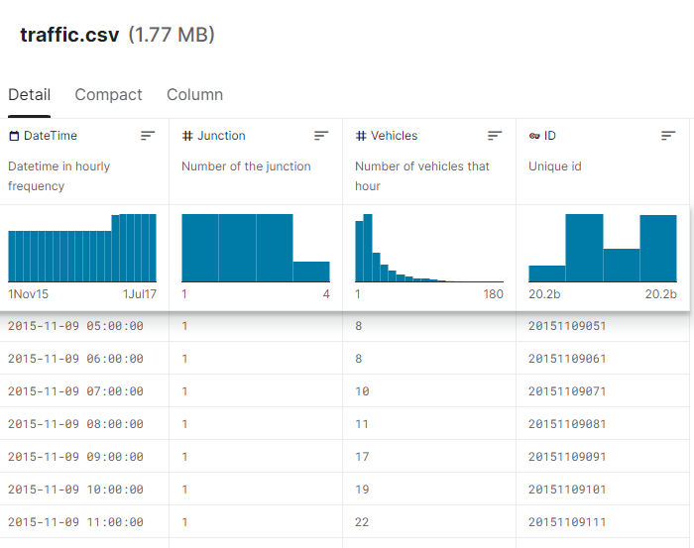



DataSet Description
Features
Collection
A CSV file with
Number of Instances: 48120
Number of Attributes: 4
The data was collected in between 2015-2017 at different time periods in a day
Data Source
https://www.kaggle.com/datasets/fedesoriano/traffic-prediction-dataset
Data Quality
Some of the junctions have provided limited or sparse data, E.g.-4th junction

Slide 7
Our Approach
Data Preprocessing
Exploratory Data Analysis
Modelling
Deployment
Different Observations and changes were made on Dataset such as: checking Missing Values, converting and extracting time frames, as well as checking Data Quality.
We got insights on vehicular movement for each junctions.
Different line graphs are used to visualize cumulative traffic over different time periods.
Bivariate analysis is done to understand the association between variables.
New features were created by encoding target to understand the time and date clearly.
Dataset was trained on different models such as : CatBoost,Random Forest, LGBM, XgBoost out of which LGBM was selected
At present we have deployed our working model using : Streamlit
Notes:
Why is Bivariate analysis done? - to understand statistical association between variables to understand the degree of association if one does exist, and whether one variable may be predicted from another
Mention the reason why Random Forest was used.

Slide 8
EDA-Exploratory Data Analysis
1
Checking The Level of Correlation of Other Columns On The Target Column(Vehicles)
4
Visualizing Daily Traffic situation using different features
Topics Handled during EDA
2
Extracting and Visualizing Total Vehicular Movement for each Junctions
5
Bivariate Analysis On Junctions and exporting clean processed data.
3
Using a time series chart (Line Chart) to visualize vehicular movement volume for each junction for the duration under review

Slide 9
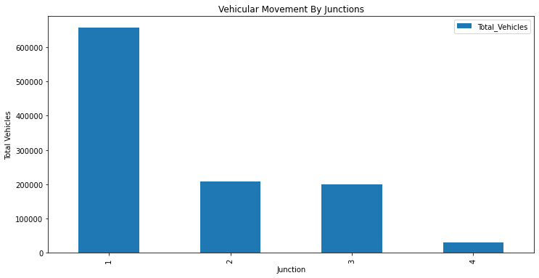
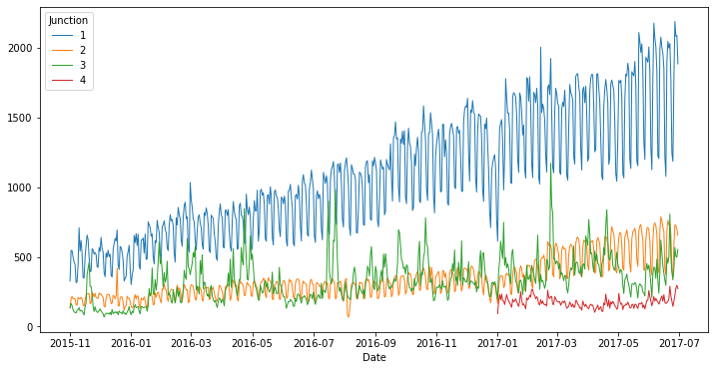
Outcome:
Junction 1 has highest cumulative vehicular movement.
Junction 4 has very little vehicle movement in compare to others due to the fact that it came at later date of the period under consideration.
Line graph shows constant growing rate of vehicular movement for Junction 1, Other Junctions experienced Fluctuation but constant vehicular flow over the period in consideration
Notes:
Start by saying some of the observations

Slide 10
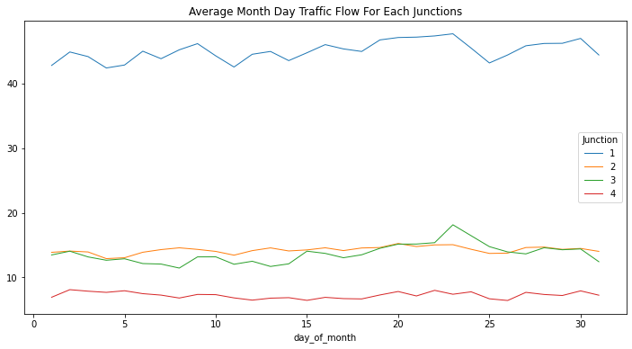
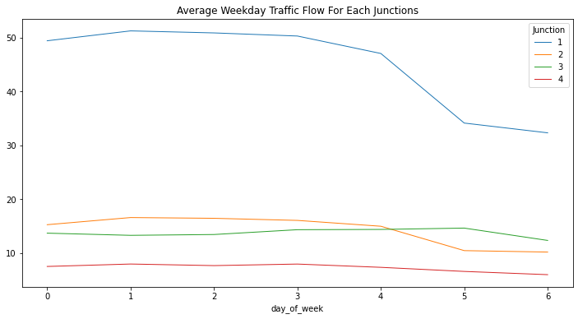
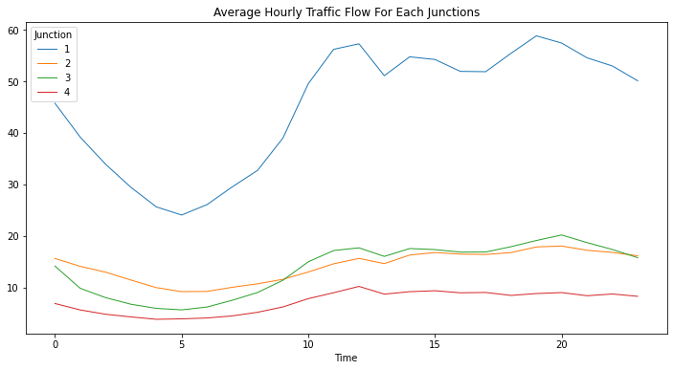
The Average Month_Daily Traffic Visualization Portrayed a Steady flow across all Junctions throughout the months of the period in consideration.
Average traffic flow was observed to be steady across all junctions until Fourth day (Thursday) where there is a sharp drop of movement till rest of the week
The Hourly Analysis Shows Least Traffic situation at early period of the day, with peak traffic experienced at the later hour of the day
Notes:
We made observations about this visuals. Pls relate with the EDA guys for the correction - using AVERAGE for all. /////DONE

Slide 11



Model Evaluation and tuning
Feature Extraction and Engg.
Step-1
Extracting new features for the DateTime Column
Tuning hyperparameters for the chosen model(LGBM) and checking feature importance to get rid of unimportant features
Step- 4
Step-2
Modeling
Feature Scaling and selection
Step- 3
Using Target Encoding to create new features such as {Junction, ID, Year, Month, day_of_month, day_of_week, Date, Time, day_of_year} with aggregates: Std, Max, Min, Mean and Median.
Building Baseline Model with the best performing Models (CatBoost, LGBM, RandomForest, and XGBoost later checking for overfitting using stratified cross validation(SCV) to choose the best model.
Reiterating to get best results
Notes:
Speaker needs to focus on feature engineering cross validation .
This slide page has no heading - is this the pre modeling phase still between EDA and Modelling phase

Slide 12
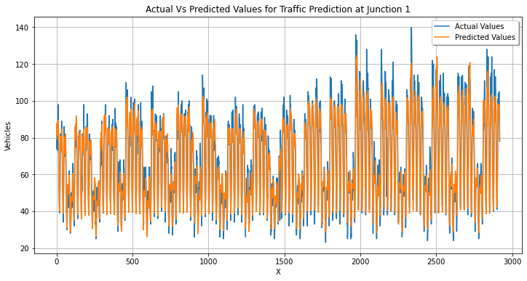
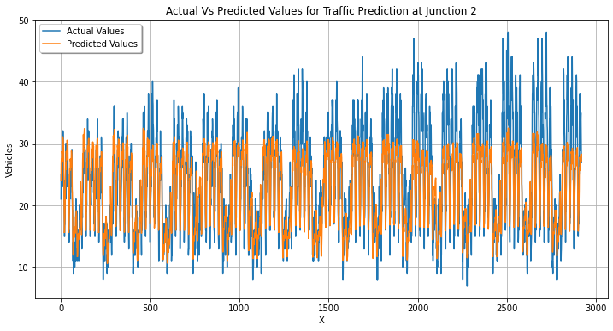
Modelling
Separating the Dataset into 4 for each junction and then applying different models to find the best among.
The datasets was trained and tested on different models out of which some are XgBoost, prophet, Ridge, Lasso, ARIMA, LGBM.

Slide 13
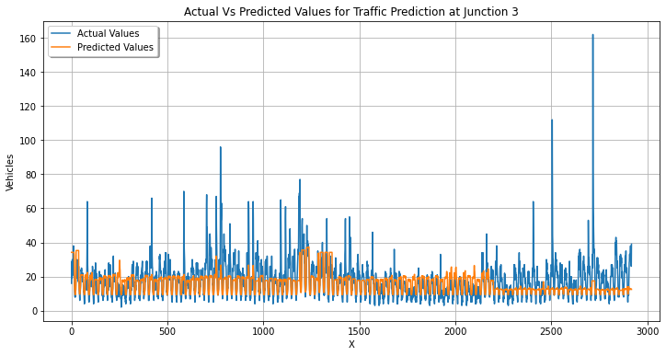
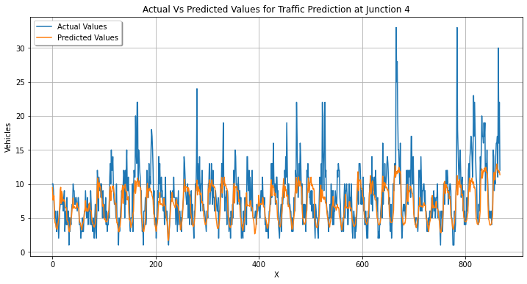
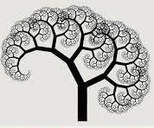
The LGBM model's work on the actual vs. predicted depends on the values of RMSE and MAPE. To enhance the performance remodeling was done after feature selection.
Light GBM is sensitive to overfitting and can easily overfit small data hence we used cross validation to prevent it.
LGBM(Light Gradient Boosting Machine)
Notes:
LGBM OVERFITTING- We need to partition the data into k folds then iteratively train the algorithm on k-1 folds while using the remaining holdout fold as the test set.

Slide 14
Performance of Baseline Models for Junction-1
S.No. | Model | RMSE result | MAPE result
1. | LinearRegression | 12.854838049478685 | 15.230175433082712
2. | Lasso Regression | 12.790992639284456 | 17.673073879384713 %
3. | Ridge Regression | 12.695813291399535 | 15.475676546307163 %
4. | CatBoost | 17.109869105557205 | 17.215516167453515
5. | LGBM | 7.026064213871266 | 7.906486965945958 %
6. | XGBoost | 8.201345201899674 | 8.987725494195764 %
7. | AdaBoost | 10.104497298871369 | 13.934631015715288 %
8. | Gradient Boosting | 7.481111075750063 | 8.651359876334292 %
9. | Decision Tree | 9.052603107917205 | 9.769646512250842 %
10. | RandomForest | 7.0100255851596 | 7.6892603132561534 %
11. | SVC | 37.67605672430806 | 38.914947586404146 %
12. | LinearSVC | 71.20715948093552 | 100.0 %
Notes:
You need not waste time over here on these slides you can mention it as : this are some of the statistical values which tells about RMSE and MAPE VALUES WHICH ARE observed from modeling and forward to conclusion or deployment.

Slide 15
Performance of Baseline Models for Junction-2
S.No. | Model | RMSE result | MAPE result
1. | LinearRegression | 7.6277505677670785 | 21.368942379124352 %
2. | Lasso Regression | 8.612488048386004 | 25.109017538807727 %
3. | Ridge Regression | 7.9319416804565686 | 22.272597036913595 %
4. | CatBoost | 7.177207066865056 | 19.70508273811693 %
5. | LGBM | 4.583477909858874 | 13.839091072778196 %
6. | XGBoost | 4.632021473294074 | 15.688251300479102 %
7. | AdaBoost | 5.839894577418032 | 19.04533120915168 %
8. | Gradient Boosting | 5.061104413529052 | 15.636265045122451 %
9. | Decision Tree | 5.617521302065868 | 17.55499755557056 %
10. | RandomForest | 4.932234519399123 | 15.287121457850638 %
11. | SVC | 13.920348648384735 | 41.99686683700703 %
12. | LinearSVC | 25.088684374014456 | 100.0 %

Slide 16
Performance of Baseline Models for Junction-3
S.No. | Model | RMSE result | MAPE result
1. | LinearRegression | 8.41861572088234 | 41.727789384930176 %
2. | Lasso Regression | 8.581688626614895 | 49.20684317335338 %
3. | Ridge Regression | 8.529474802839362 | 44.6548040422754 %
4. | CatBoost | 10.028168824555438 | 45.98276038083423 %
5. | LGBM | 9.437155586207757 | 39.265525191018035 %
6. | XGBoost | 10.644477918052637 | 57.29594652061177 %
7. | AdaBoost | 12.68222675062862 | 76.0354321677195 %
8. | Gradient Boosting | 9.925742860665057 | 46.99050464304999 %
9. | Decision Tree | 14.463622207971083 | 67.26136243824786 %
10. | RandomForest | 11.028846831832755 | 52.27833142970732 %
11. | SVC | 12.07547566484615 | 44.53900661761735 %
12. | LinearSVC | 20.4138806946924 | 100.0 %

Slide 17
Performance of Baseline Models for Junction-4
S.No. | Model | RMSE result | MAPE result
1. | LinearRegression | 3.646906308065977 | 31.399350412569294 %
2. | Lasso Regression | 3.691967997087228 | 31.641517694440687 %
3. | Ridge Regression | 3.646824566387416 | 31.389218800647022 %
4. | CatBoost | 3.5471524124797567 | 31.749286123331505 %
5. | LGBM | 3.2792283230912003 | 28.99305256768312 %
6. | XGBoost | 3.3303064364129913 | 33.9647687330588 %
7. | AdaBoost | 3.3661641507764424 | 40.53905093001448 %
8. | Gradient Boosting | 3.29856612846931 | 29.364646258619644 %
9. | Decision Tree | 4.77753961706512 | 42.35146095145538 %
10. | RandomForest | 3.3031351187777998 | 30.246824913173455 %
11. | SVC | 4.428276933216056 | 47.955973746362275 %
12. | LinearSVC | 9.1973999531725 | 9.1973999531725

Slide 18
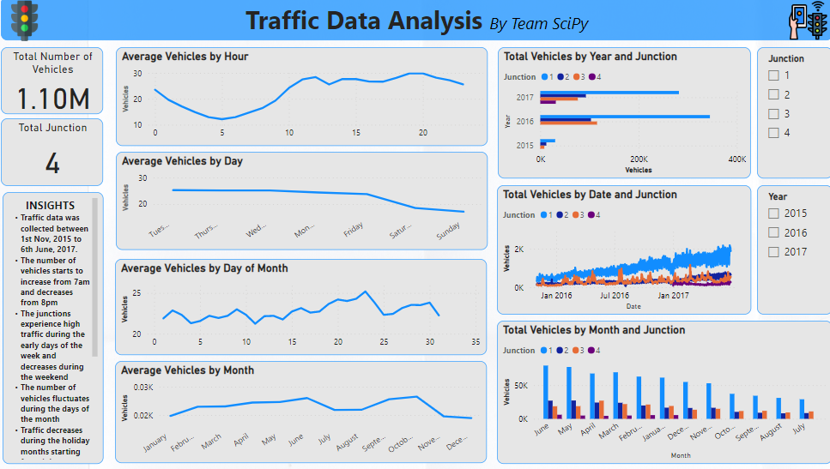
Power Bi Dashboard
Click!!

Slide 19
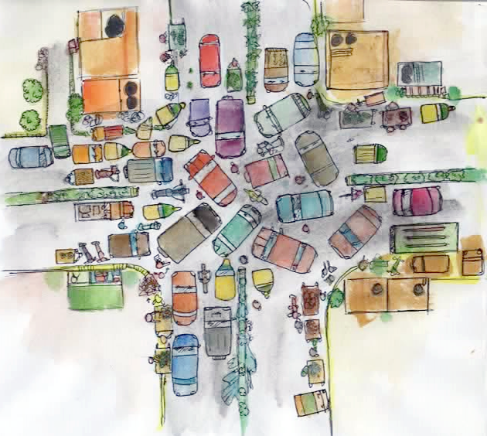
Deployment
Click!!
Notes:
Click on image to show the live demo if project!!

Slide 20
Conclusion
Junction 4 was created to reduce the overall traffic situation on the axis which seemed to work.
We performed Prophet which is robust to missing data and shifts in the trend, and typically handles outliers well but as there were no missing data the chances of overfitting increased.
If additional data is to be added in future then the model may vary depending upon the time series formed by the training data.
Insights from EDA
We notice a daily increase in Vehicular movement at all the junctions except junction 4 which started recording data from January 2017.
With the exception of junction 4, We notice the data increasing during the morning time, around 6am, stays steady throughout the afternoon, and decreases during the evening time around 8pm.
The ARIMAX model has drawbacks because of Poorer performance for long term forecasts and as the data is not stationary it is not advisable to use ARIMAX
Depending upon evaluation indexes LGBM was found most suitable for all junctions. Only for junction 1 Random forest performed well but on an average LGBM gave best results
Notes:
CONGRATULATIONS! PLS ENSURE TO MAKE THIS CONCLUSION SIMPLE AND BRIEF.

Slide 21
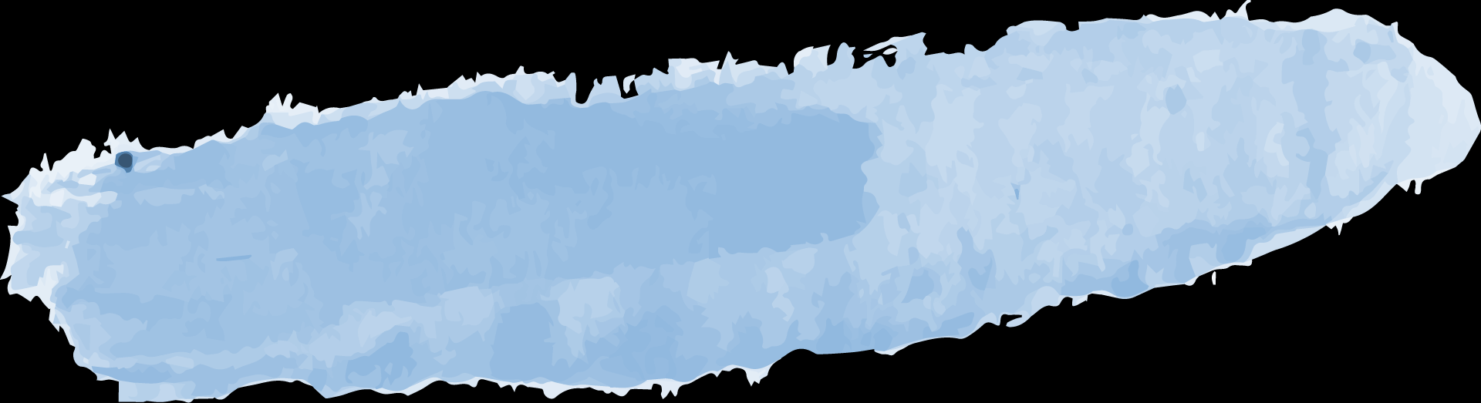
Thank you!
Remark
Comments
Where could we improve?

